Slide 1
Linux Kernel Internals

Slide 2
Outline
Linux Introduction
Linux Kernel Architecture
Linux Kernel Components

Slide 3
Linux Introduction

Slide 4
Linux Introduction
History
Features
Resources

Slide 5
Features
Free
Open system
Open source
GNU GPL (General Public License)
POSIX standard
High portability
High performance
Robust
Large development toolset
Large number of device drivers
Large number of application programs

Slide 6
Features (Cont.)
Multi-tasking
Multi-user
Multi-processing
Virtual memory
Monolithic kernel
Loadable kernel modules
Networking
Shared libraries
Support different file systems
Support different executable file formats
Support different networking protocols
Support different architectures

Slide 7
Resources
Distributions
Books
Magazines
Web sites
ftp cites
bbs

Slide 8
Linux Kernel Architecture

Slide 9
Linux Kernel Architecture
User View of Linux Operating System
Linux Kernel Architecture
Kernel Source Code Organization

Slide 10
User View of Linux Operating System
Applications
Shell
Kernel
Hardware

Slide 11
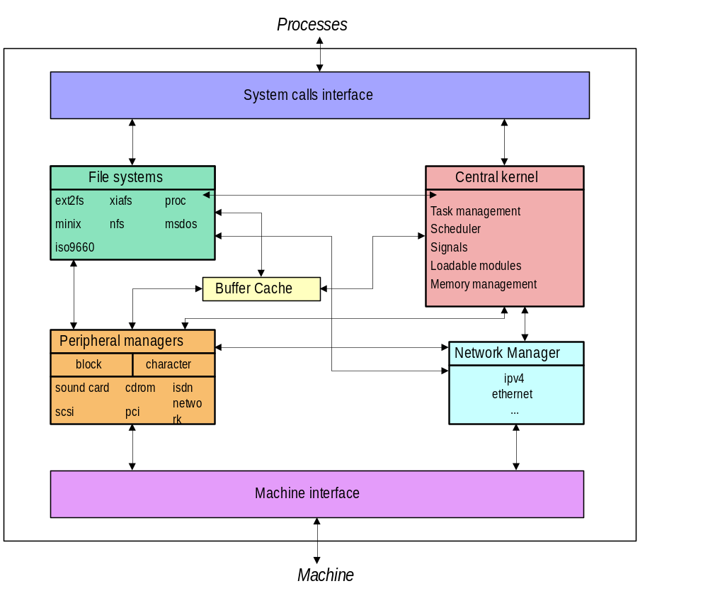
System Structure

Slide 12
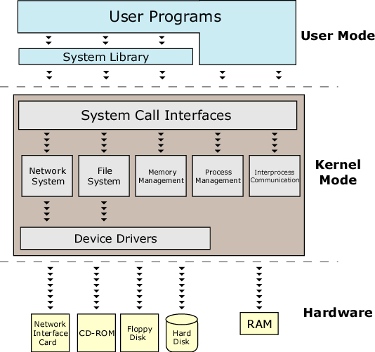
Linux Kernel Architecture

Slide 13
Analysis of Linux Kernel Architecture
Stability
Safety
Speed
Brevity
Compatability
Portability
Reusability and modifiability
Monolithic kernel vs. microkernel
Linux takes the advantages of monolithic kernel and microkernel

Slide 14
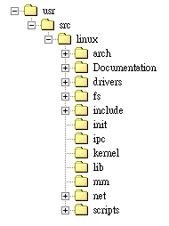
Kernel Source Code Organization
Source code web site:
http://www.kernel.org
Source code version:
  X.Y.Z
  2.2.17
  2.4.0

Slide 15
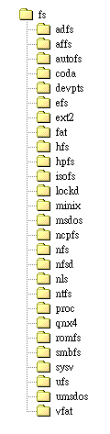
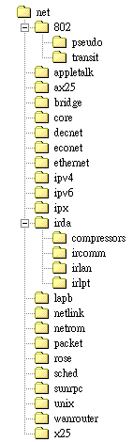
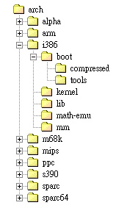
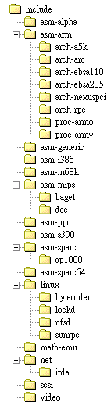

Kernel Source Code Organization (Cont.)

Slide 16
Resources for Tracing Linux
Source code browser
  cscope
  Global
  LXR (Source code navigator)
Books
  Understanding the Linux Kernel, D. P. Bovet and M. Cesati, O'Reilly & Associates, 2000.
  Linux Core Kernel – Commentary, In-Depth Code Annotation, S. Maxwell, Coriolis Open Press, 1999.
  The Linux Kernel, Version 0.8-3, D. A Rusling, 1998.
  Linux Kernel Internals, 2nd edition, M. Beck et al., Addison-Wesley, 1998.
  Linux Kernel, R. Card et al., John Wiley & Sons, 1998.

Slide 17
How to compile Linux Kernel
1. make config (make manuconfig)
2. make depend
3. make boot
generate a compressed bootable linux kernel
arch/i386/boot/zIamge
make zdisk
generate kernel and write to disk
dd if=zImage of=/dev/fd0
make zlilo
generate kernel and copy to /vmlinuz
lilo: Linux Loader

Slide 18
Linux Kernel Components

Slide 19
Linux Kernel Components
Bootstrap and system initializaiton
Memory management
Process management
Interprocess communication
File system
Networking
Device control and device drivers

Slide 20
Bootstrap and System Initialization
Events From Power-On To Linux Kernel Running

Slide 21
Bootstrap and System Initialization
Booting the PC (Events From Power On)
  Perform POST procedure
  Select boot device
  Load bootstrap program (bootsect.S) from floppy or HD
Bootstrap program
  Hardware Initialization (setup.S)
  loads Linux kernel into memory (head.S)
  Initializes the Linux kernel
  Turn bootstrap sequence to start the first init process

Slide 22
Bootstrap and System Initialization (Cont.)
Init process
  Create various system daemons
  Initialize kernel data structures
  Free initial memory unused afterwards
  Runs shell
Shell accepts and executes user commands

Slide 23
Low-level Hardware Resource Handling
Interrupt handling
Trap/Exception handling
System call handling

Slide 24
Memory Management

Slide 25
Memory Management Subsystem
Provides virtual memory mechanism
  Overcome memory limitation
  Makes the system appear to have more memory than it actually has by sharing it between competing processes as they need it.
It provides:
  Large address spaces
  Protection
  Memory mapping
  Fair physical memory allocation
  Shared virtual memory

Slide 26
Memory Management
x86 Memory Management
  Segmentation
  Paging
Linux Memory Management
  Memory Initialization
  Memory Allocation & Deallocation
  Memory Map
  Page Fault Handling
  Demand Paging and Page Replacement

Slide 27
Segment Translation
15
0
31
0
logical address
Selector
Offset
Segment
Descriptor
base address
+
linear address
Segment Descriptor Table
Dir
Page
Offset

Slide 28
Linear Address Translation
linear address
31 22 21 12 11 0
Directory
Table
Offset
12
10
10
Physical Address
Page-Table Entry
Directory Entry
Page table
Page directory
32
Physical memory
CR3(PDBR)

Slide 29
Segmentation and Paging
Logical Address
Segment
Selector
Linear Address
Space
Offset
Linear Address
Physical Address
Space
Dir
Table
Offset
Page
Page Table
Segment
Page
Directory
Segment
Descriptor
Page
Segment Base Address

Slide 30
Abstract model of Virtual to Physical address mapping
Process X
Process Y
VPFN7
Process X
Page Table
Process Y
Page Table
VPFN7
VPFN6
VPFN6
VPFN5
VPFN5
PFN4
VPFN4
VPFN4
PFN3
VPFN3
VPFN3
PFN2
VPFN2
VPFN2
PFN1
VPFN1
VPFN1
PFN0
VPFN0
VPFN0
Physical Memory
Virtual Memory
Virtual Memory

Slide 31
An Abstract Model of VM (Cont.)
Each page table entry contains:
  Valid flag
  Physical page frame number
  Access control information
X86 page table entry and page directory entry:
31 12 6 5 2 1 0
U
/
S
R
/
W
Page Address
D
A
P

Slide 32
Demand Paging
Loading virtual pages into memory as they are accessed
Page fault handling
  faulting virtual address is invalid
  faulting virtual address was valid but the page is not currently in memory

Slide 33
Swapping
If a process needs to bring a virtual page into physical memory and there are no free physical pages available:
Linux uses a Least Recently Used page aging technique to choose pages which might be removed from the system.
Kernel Swap Daemon (kswapd)

Slide 34
Caches
To improve performance, Linux uses a number of memory management related caches:
  Buffer Cache
  Page Caches
  Swap Cache
  Hardware Caches (Translation Look-aside Buffers)

Slide 35
Page Allocation and Deallocation
Linux uses the Buddy algorithm to effectively allocate and deallocate blocks of pages.
Pages are allocated in blocks which are powers of 2 in size.
  If the block of pages found is larger than requested must be broken down until there is a block of the right size.
The page deallocation codes recombine pages into large blocks of free pages whenever it can.
  Whenever a block of pages is freed, the adjacent or buddy block of the same size is checked to see if it is free.

Slide 36
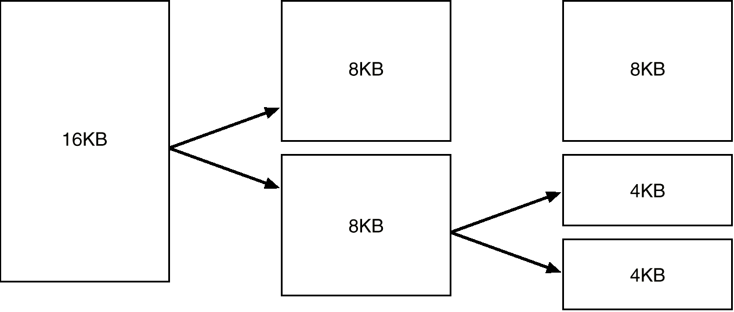
Splitting of Memory in a Buddy Heap

Slide 37
Vmlist for virtual memory allocation vmalloc() & vfree()
first-fit algorithm
vmlist
addr
addr+size
VMALLOC_START
VMALLOC_END
：Allocated space
：Unallocated space

Slide 38
Process Management

Slide 39
What is a Process ?
A program in execution.
A process includes program's instructions and data, program counter and all CPU's registers, process stacks containing temporary data.
Each individual process runs in its own virtual address space and is not capable of interacting with another process except through secure, kernel managed mechanisms.

Slide 40
Linux Processes
Each process is represented by a task_struct data structure, containing:
  Process State
  Scheduling Information
  Identifiers
  Inter-Process Communication
  Times and Timers
  File system
  Virtual memory
  Processor Specific Context

Slide 41
Process State
stopped
creation
signal
signal
executing
termination
zombie
ready
scheduling
suspended
input / output
end of
input / output

Slide 42
Process Relationship
parent
p_pptr
p_opptr
p_pptr
p_opptr
p_cptr
p_pptr
p_opptr
p_osptr
p_osptr
oldest
child
youngest
child
p_ysptr
child
p_ysptr

Slide 43
Managing Tasks
struct task_struct
pidhash
task
next_task
prev_task
tarray_freelist

Slide 44
Scheduling
As well as the normal type of process, Linux supports real time processes. The scheduler treats real time processes differently from normal user processes
Pre-emptive scheduling.
Priority based scheduling algorithm
Time-slice: 200ms
Schedule: select the most deserving process to run
  Priority: weight
    Normal : counter
    Real Time : counter + 1000

Slide 45
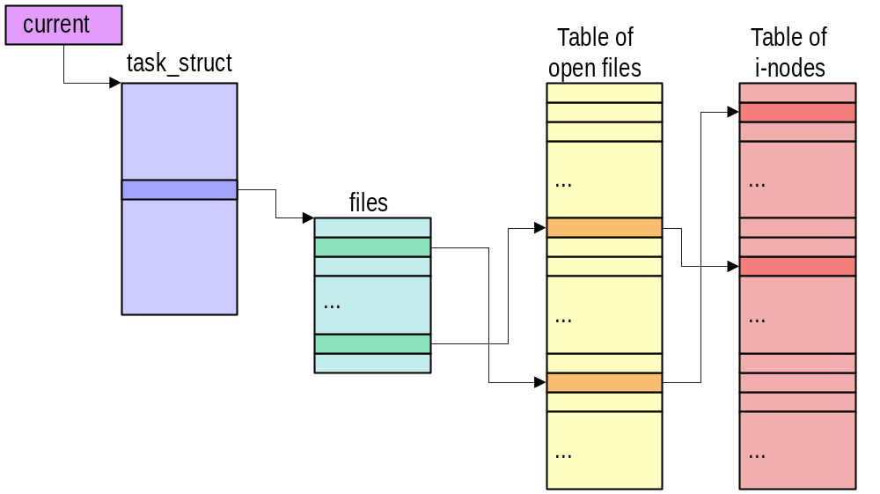
A Process's Files

Slide 46
Virtual Memory
A process's virtual memory contains executable code and data from many sources.
Processes can allocate (virtual) memory to use during their processing
Demand paging is used where the virtual memory of a process is brought into physical memory only when a process attempts to use it.

Slide 47
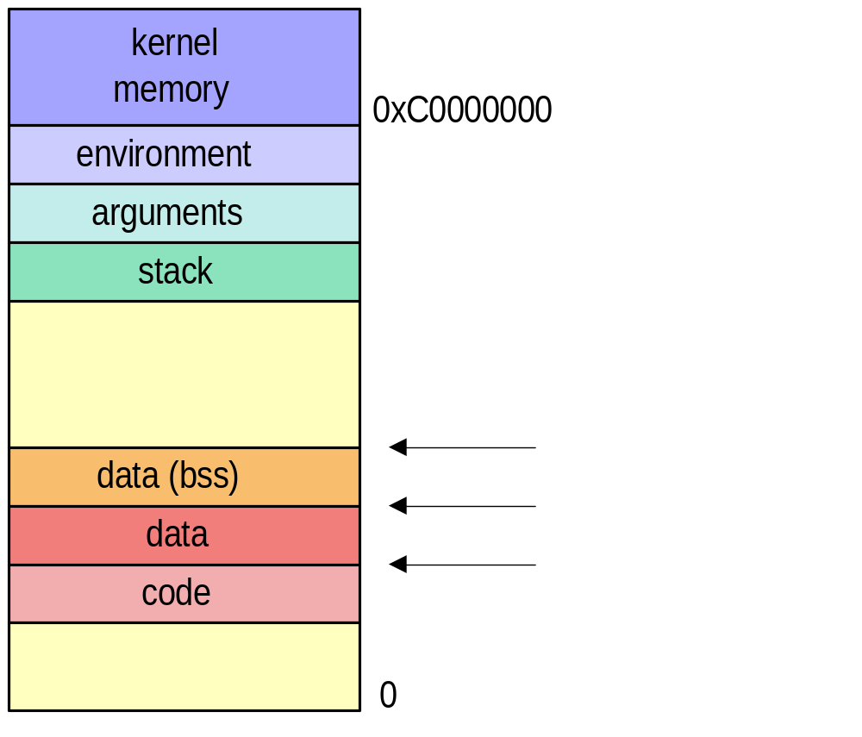
Process Address Space

Slide 48
A Process’s Virtual Memory
Process’s
Virtual Memory
task_struct
vm_area_struct
mm_struct
vm_end
vm_start
vm_flags
vm_inode
vm_ops
vm_next
mm
count
pgd
mmap
mmap_avl
mmap_sem
data
vm_area_struct
vm_end
vm_start
vm_flags
vm_inode
vm_ops
vm_next
code

Slide 49
Process Creation and Execution
UNX process management separates the creation of processes and the running of a new program into two distinct operations.
  The fork system call creates a new process.
  A new program is run after a call to execve.

Slide 50
Executing Programs
Programs and commands are normally executed by a command interpreter.
A command interpreter is a user process like any other process and is called a shell
ex.sh, bash and tcsh
Executable object files:
  Contain executable code and data together with information to be loaded and executed by OS
Linux Binary Format
  ELF, a.out, script

Slide 51
How to execute a program?
Command enter
Search file in
process’s search path(PATH)
Shell clone itself and binary image is replaced with
executable image

Slide 52
ELF
ELF (Executable and Linkable Format) object file format
  designed by Unix System Laboratories
  the most commonly used
  format in Linux
Format header
Physical header
(Code)
Physical header
(Data)
Code
Data

Slide 53
Interprocess Communication Mechanisms (IPC)
Signals
Pipes
Message Queues
Semaphores
Shared Memory

Slide 54
Signals
Signals inform processes of the occurrence of asynchronous events.
Processes may send each other signals by kill system call, or kernel may send signals to a process.
A set of defined signals in the system:
    1)SIGHUP 2) SIGINT 3) SIGQUIT 4) SIGILL
    5) SIGTRAP 6) SIGIOT 7) SIGBUS 8) SIGFPE
    9) SIGKILL 10) SIGUSR1 11) SIGSEGV 12) SIGUSR2
    13) SIGPIPE 14) SIGALR 15)SIGTERM
    17) SIGCHLD 18) SIGCONT 19) SIGSTOP 20) SIGTSTP
    21) SIGTTIN 22) SIGTTOU 23) SIGURG 24) SIGXCPU
    25) SIGXFSZ 26) SIGVTALRM 27) SIGPROF 28) SIGWINCH
    29) SIGIO 30) SIGPWR

Slide 55
Signals (Cont.)
A process can choose to block or handle signals itself or allow kernel to handle it
Kernel handles signals using default actions.
  E.g., SIGFPE(floating point exception) : core dump and exit
Signal related fields in task_struct data structure
  signal (32 bits): pending signals
  blocked: a mask of blocked signal
  sigaction array: address of handling routine or a flag to let kernel handle the signal

Slide 56
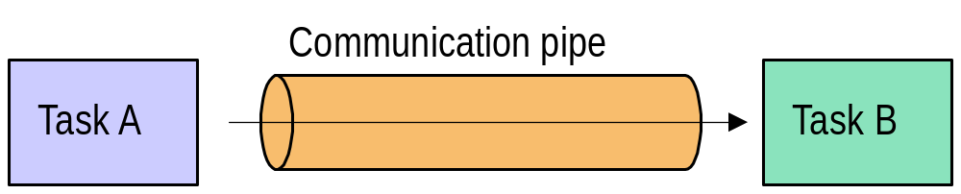
Pipes
one-way flow of data
The writer and the reader communicate using standard read/write library function

Slide 57
Restriction of Pipes and Signals
Pipe:
  Impossible for any arbitrary process to read or write in a pipe unless it is the child of the process which created it.
  Named Pipes (also known as FIFO)
    also one-way flow of data
    allowing unrelated processes to access a single FIFO.
Signal
  The only information transported is a simple number, which renders signals unsuitable for transferring data.

Slide 58
System V IPC Mechanism
Linux supports 3 types of IPC mechanisms:
  Message queues, semaphores and shared memory
  First appeared in UNIX System V in 1983
They allow unrelated processes to communicate with each other.

Slide 59
Key Management
Processes may access these IPC resources only by passing a unique reference identifier to the kernel via system calls.
Senders and receivers must agree on a common key to find the reference identifier for the System V IPC object.
Access to these System V IPC objects is checked using access permissions.

Slide 60
Shared Memory and Semaphores
Shared memory
  Allow processes to communicate via memory that appears in all of their virtual address space
  As with all System V IPC objects, access to shared memory areas is controlled via keys and access rights checking.
  Must rely on other mechanisms (e.g. semaphores) to synchronize access to the memory
Semaphores
  A semaphore is a location in memory whose value can be tested and set (atomic) by more than one processes
  Can be used to implement critical regions

Slide 61
Sys_shmget()
Sys_shmat()
Create Segment
Process to attach segment For read and write
Give a valid IPC identifier
Remove or detach segment
Execute commands about Shared memory
Sys_shmdt()
Sys_shmctl()

Slide 62
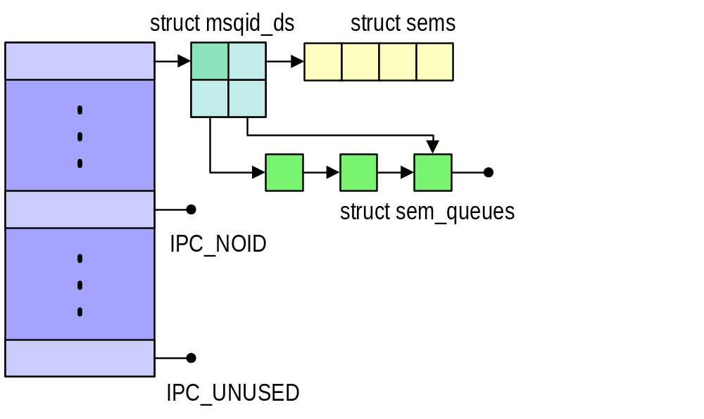
Semaphores

Slide 63
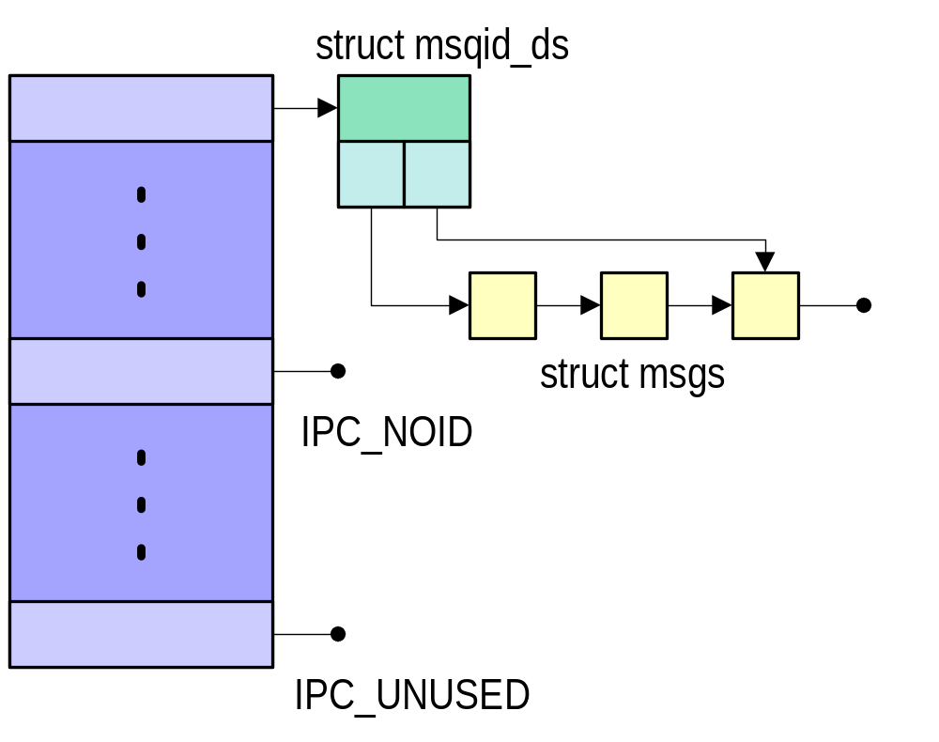
Message Queues
Allow one or more processes to write messages, which will be read by one or more reading processes

Slide 64
File System

Slide 65
Linux File System
Linux supports different file system structures at the same time
  Ext2, ISO 9660, ufs, FAT-16,VFAT,…
Hierarchical File System Structure
  Linux adds each new file system into this single file system tree as it is mounted.
The real file systems are separated from the OS by an interface layer: Virtual File System: VFS
VFS allows Linux to support many different file systems, each presenting a common software interface to the VFS.

Slide 66
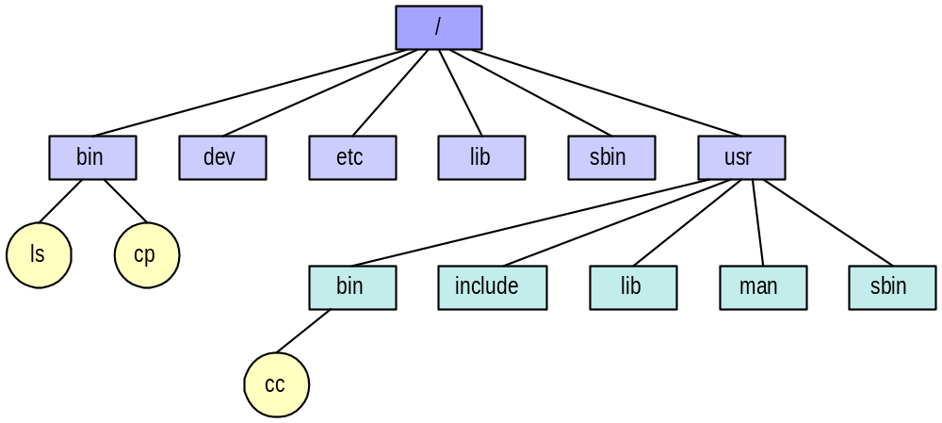
Hierarchical File System Structure

Slide 67
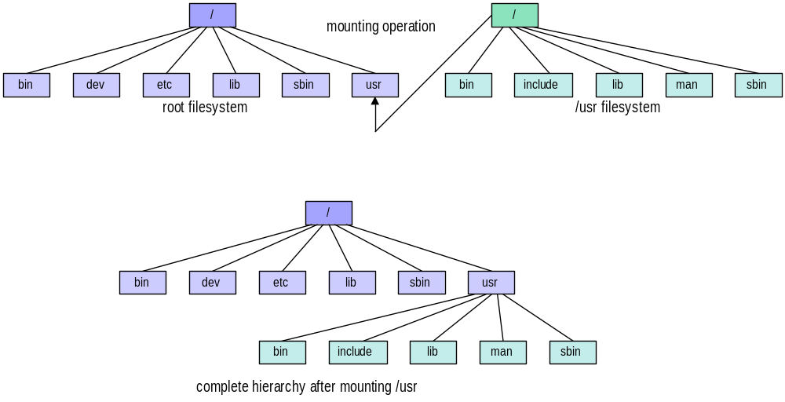
Mounting of Filesystems

Slide 68
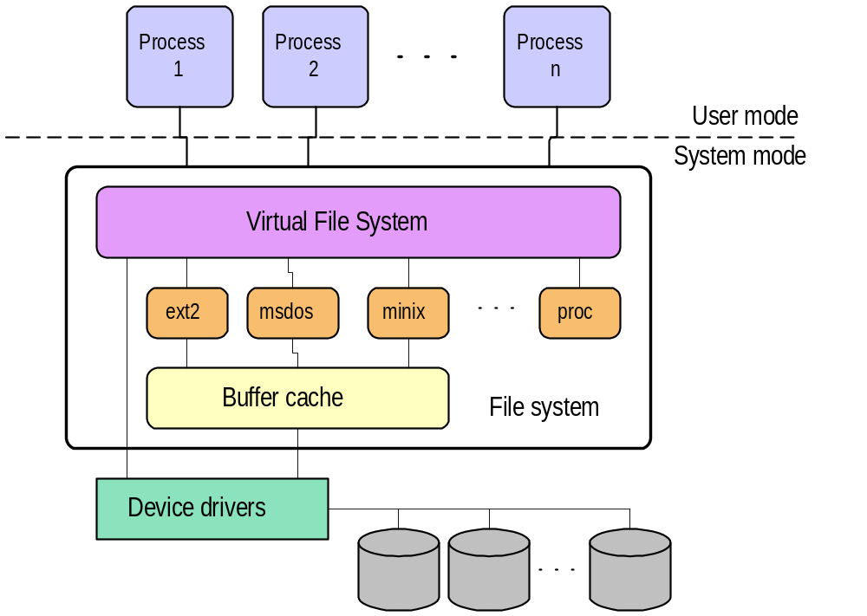
The Layers in the File System

Slide 69
Ext2 File System
Devised (by Rémy Card) as an extensible and powerful file system for Linux.
Allocation space to files
  Data in files is kept in fixed-size data blocks
  Indexed allocation (inode)
directory : special file which contains pointers to the inodes of its directory entries
Divides the logical partition that it occupies into Block Groups.

Slide 70
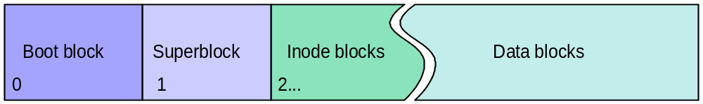
Physical Layout of File Systems
Schematic Structure of a UNIX File System
Physical Layout of EXT2 File System
Block
Group 0
Block
Group 1
…...
Block
Group n
Super
block
Group
descriptors
Block
bitmap
Inode
bitmap
Inode
table
Data
blocks

Slide 71
The EXT2 Inode
Mode
Owner Info
Size
Timestamps
data
Direct Blocks
data
data
Indirect blocks
data
Double Indirect
data
Triple Indirect
data
data

Slide 72
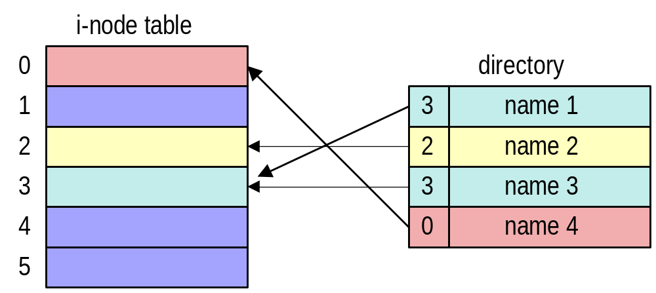
Directory Format

Slide 73
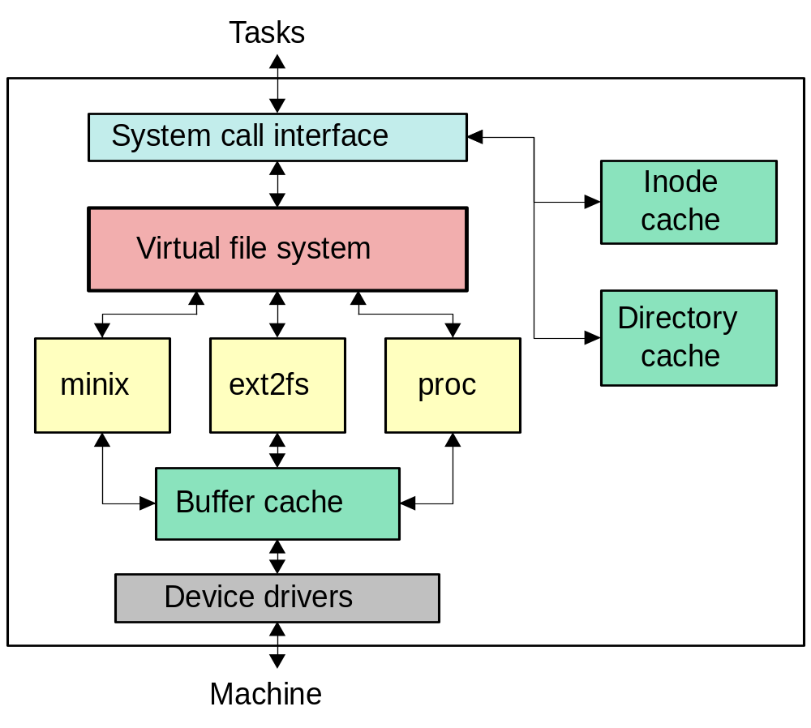
The Virtual File System (VFS)

Slide 74
Allocating Blocks to a File
To avoid fragmentation that file blocks may spread all over the file system, EXT2 file system:
  Allocating the new blocks for a file physically close to its current data blocks or at least in the same Block Group as its current data blocks as possible.
  Block preallocation

Slide 75
Speedup Access
VFS Inode Cache
Directory Cache
  stores the mapping between the full directory names and their inode numbers.
Buffer Cache
  All of the Linux file systems use a common buffer cache to cache data buffers from the underlying devices
Replacement policy: LRU

Slide 76
bdflush & update Kernel Daemons
The bdflush kernel daemon
  provides a dynamic response to the system having too many dirty buffers (default:60%).
  tries to write a reasonable number of dirty buffers out to their owning disks (default:500).
The update daemon
  periodically flush all older dirty buffers out to disk

Slide 77
The /proc File System
It does not really exist.
Presents a user readable windows into the kernel’s inner workings.
The /proc file system serves information about the running system. It not only allows access to process data but also allows you to request the kernel status by reading files in the hierarchy.
System information
  Process-Specific Subdirectories
  Kernel data
  IDE devices in /proc/ide
  Networking info in /proc/net, SCSI info
  Parallel port info in /proc/parport
  TTY info in /proc/tty

Slide 78
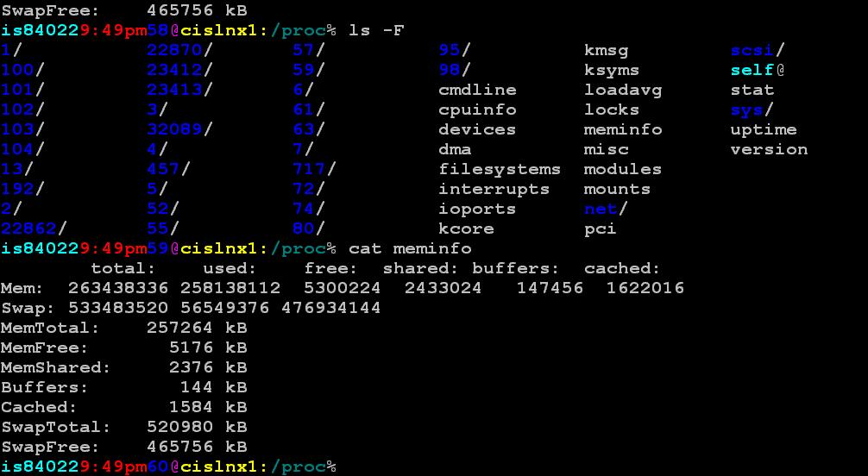

Slide 79
Networking

Slide 80
Linux Networking Layers
Network Applications
User
Kernel
BSD Sockets
Socket Interface
INET Sockets
TCP
UDP
Protocol Layers
IP
ARP
PPP
SLIP
Ethernet
Network Devices

Slide 81
Server Client Model
Server
socket( )
bind( )
listen( )
Client
socket( )
accept( )
connection establishment
connect( )
data(request)
read( )
write( )
data(replay)
write( )
read( )
close( )
connection break
close( )

Slide 82
Linux BSD Socket Data Structure
BSD Socket
File Operations
file
files_struct
f_mode
f_pos
f_flags
f_count
f_owner
f_op
f_inode
f_version
lseek
read
write
select
ioctl
close
fasync
count
close_on_exec
open_fs
fd[0]
fd[1]
fd[255]
inode
socket
type
protocol
data
SOCK_STREAM
Address Family
socket operations
SOCK_STREAM
sock
type
protocol
socket

Slide 83
Loadable Kernel Module
A Kernel Module is not an independent
executable, but an object file which will be
linked into the kernel in runtime.
Modules can be “dynamically integrated” into the kernel. When no longer used, the modules may then be unloaded.
Enable the system to have an “extended”
kernel.

Slide 84
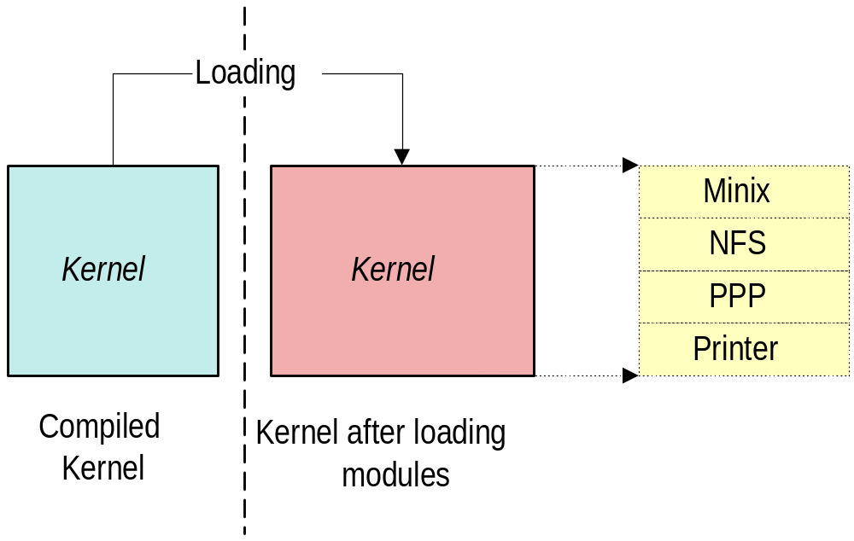
Loading Modules

